Slide 1
Math 152 – Lesson 6
Lesson | Topic | Reading
5 | FTC | 5.3
6 | Indefinite Integrals & Net Change | 5.4
7 | Substitution Rule | 5.5
Objectives:
Compute "F(b) - F(a)" by applying the NET CHANGE THEOREM to F'(x)
Explain the difference between indefinite and definite integrals

Slide 2
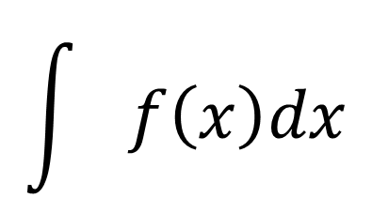
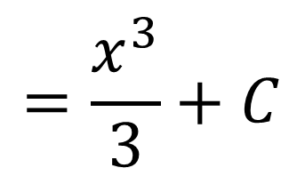
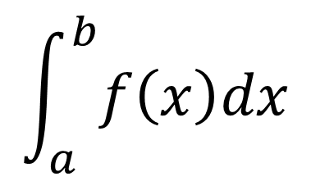
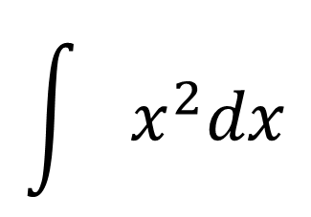


Definite v. Indefinite Integrals
Definite (number)
Indefinite (function)
$$\int_{a}^{b}{f\left(x\right)dx}$$
$$\int{f\left(x\right)dx}$$
$$\int{x^{2}dx}$$
$$\int_{1}^{3}{x^{2}dx}=\frac{3^{3}}{3}−\frac{1^{3}}{3}$$
$$=\frac{x^{3}}{3}+C$$
$$=\frac{26}{3}$$

Slide 3
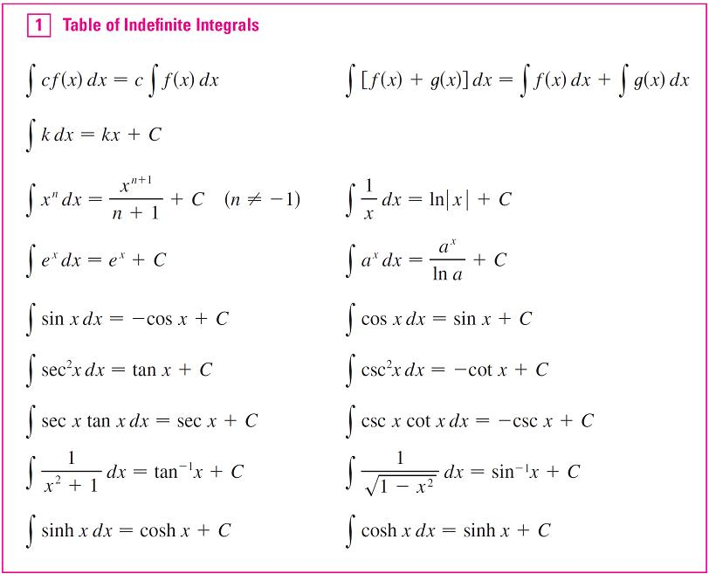
Indefinite Integrals
P 398

Slide 4

NET CHANGE THEOREM
Rate of change, velocity (m/sec)
Notes:
Pg 401

Slide 5

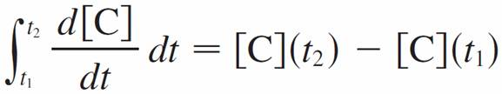
Net Change Examples
If V (t) is the volume of water in a reservoir at time t, then its derivative V ′(t) is the rate at which water flows into the reservoir at time t. So
is the change in the amount of water in the reservoir between time t₁ and time t₂.
If [C](t) is the concentration of the product of a chemical reaction at time t, then the rate of reaction is the derivative d [C]/dt. So
is the change in the concentration of C from time t₁ to time t₂.

Slide 6
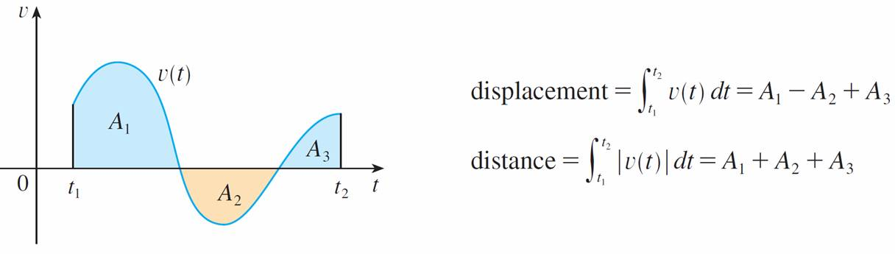
Applications
Figure 3 shows how both displacement and distance traveled can be interpreted in terms of areas under a velocity curve.

Slide 7


Board Work
Evaluate
Solution:

Slide 8
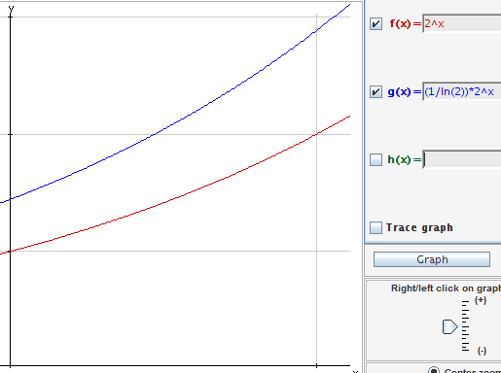
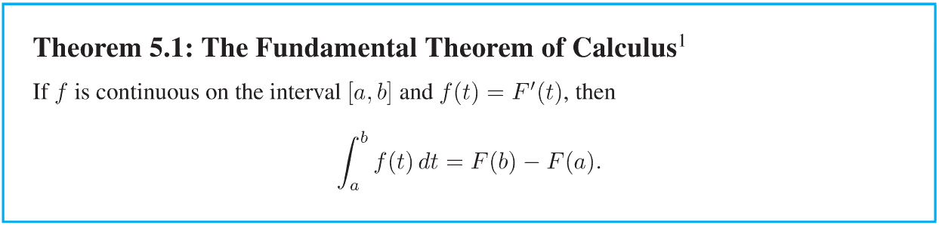



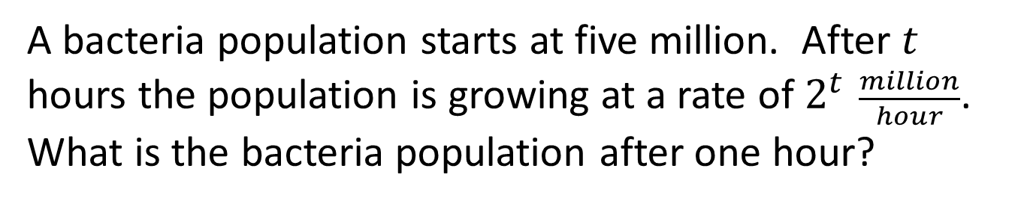
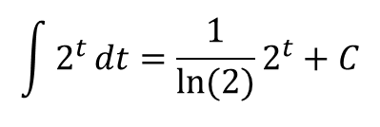


The Definite Integral of a Rate of Change
A bacteria population starts at five million. After $t$ hours the population is growing at a rate of $2^{t} \frac{million}{hour}$. What is the bacteria population after one hour?
$$The Fundamental Theorem$$
$$of Calculus, Part 2$$
P(t)
$$\int{2^{t}}dt={\frac{1}{\ln{(2)}}2}^{t}+C$$
= P(t)
P(0) = 5 $={\frac{1}{\ln{(2)}}2}^{0}+C$
5 $−{\frac{1}{\ln{(2)}}2}^{0}=C$
P(1) = ${\frac{1}{\ln{(2)}}2}^{1}+(\text{5 }−{\frac{1}{\ln{(2)}}}^{}$) = 6.44million
P(1)-P(0) = $\frac{1}{\ln{(2)}}$($2^{1}$ -${ 2}^{0}$) = 1.44
c
0 t 1
Notes:
-Integral is 1/ln(2) x 2^t
-Integrate from 0 to 5
-Change is 1/ln(2) x 2^1 - 1/ln(2) x 2^0
-Total=start+change=5M+1/ln(2) M=6.44M

Slide 10
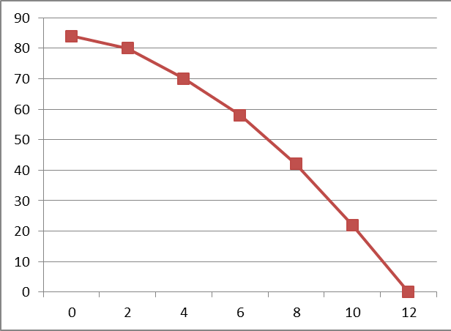
GR Practice
635
OVER estimate
UNDER estimate
UNDER estimate
OVER estimate
Notes:
595 is somewhere between LHS and RHS
Trap is still an UNDER estimate (concave down), but it is long of the deer…so, the deer is a mort
S6 = (2/3)( 1(84) + 4(80) +2(70) + 4(58) +2(42) + 4(22) + 1(0)) = (2/3)948 = 632

Slide 11
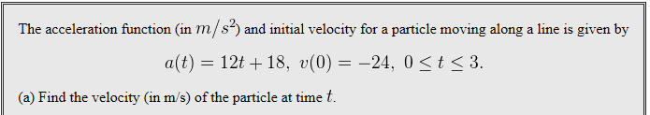
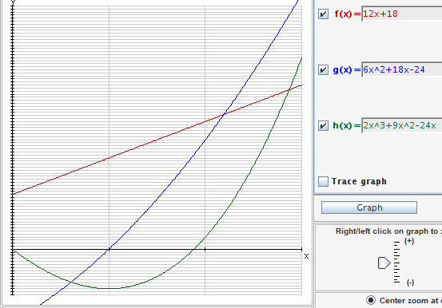
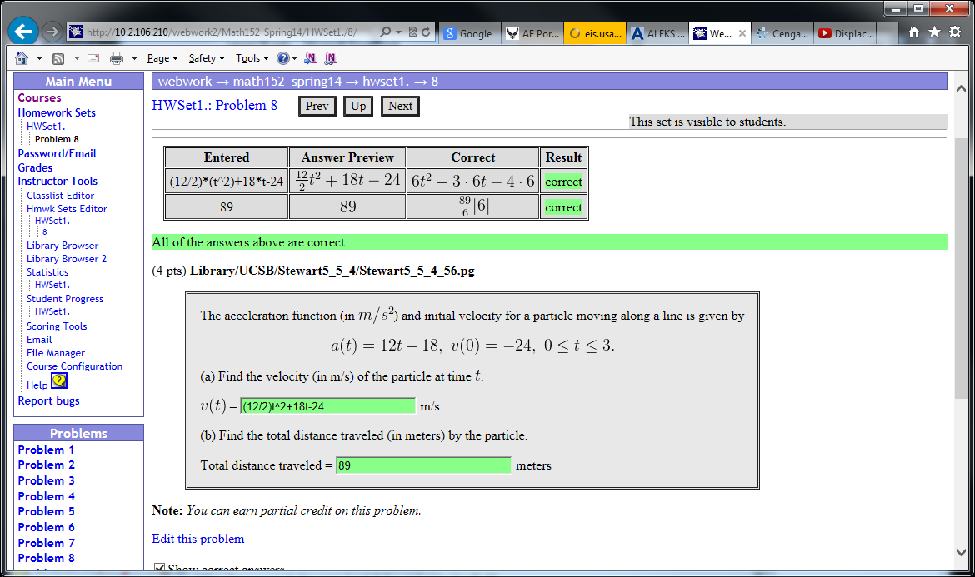


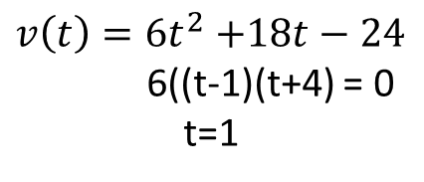

$v\left(t\right)=6t^{2}$ $+18t−24$
6((t-1)(t+4) = 0
t=1
displacement
Total distance
displacement
s$\left(t\right)=2t^{3}$ $+9t^{2}−24t+C, C=0$
Abs(s$\left(1\right)−s(0))+abs(s\left(3\right)−s(1))$
+
Abs((2+9-24) – 0) + $abs((54+$ 81 -72) – (2+9-24))
Abs((-13) – 0) + $abs((63$) – (-13)) = 89
Notes:
http://www.youtube.com/watch?v=mlwUw4gaBuM
Displacement: s(3)-s(0) = 63
Distance: abs(s(1)-s(0)) + abs(s(3)-s(0))
Remember, we are calculating the area under the BLUE (velocity) line
the GREEN (displacement) is the integral of the BLUE, or the area between the BLUE line and the X-axis

Slide 12


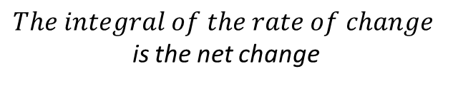
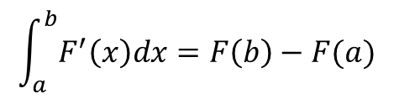
NET CHANGE THEOREM
$$The Fundamental Theorem$$
$$of Calculus, Part 2$$
$$Net Change Theorem$$
$$The integral of the rate of change$$
is the net change
$$\int_{a}^{b}{F^{′}\left(x\right)dx=F\left(b\right)−F(a)}$$
Notes:
Pg 401

Slide 13
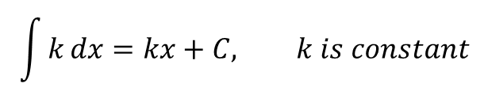

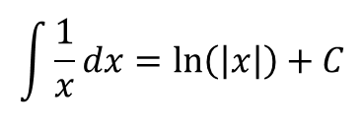
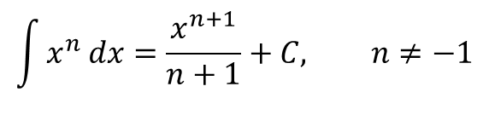
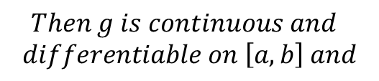

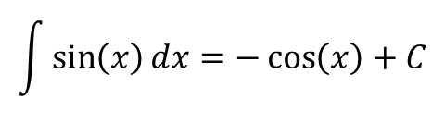

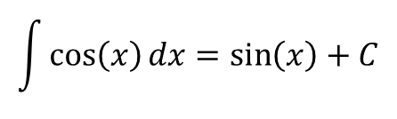


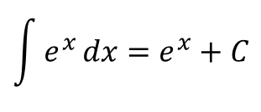
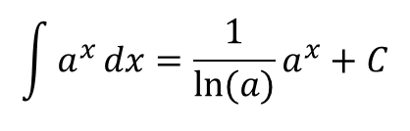
Review
Common Antiderivatives
$$\int{k}dx=kx+C, k is constant$$
$$The Fundamental Theorem$$
$of Calculus, Part$1
$$\int{x^{n}}dx=\frac{x^{n+1}}{n+1}+C, n≠−1$$
$$If f is continuous on \left[a,b\right] and$$
$$g\left(x\right)=\int_{a}^{x}{f\left(t\right) dt}$$
$$\int{\frac{1}{x}}dx=\ln\left(\left|x\right|\right)+C$$
$Then g is continuous and$
$differentiable on \left[a,b\right] and$
$$\int{a^{x}}dx={\frac{1}{\ln{(a)}}a}^{x}+C$$
$$g^{′}\left(x\right)=f(x)$$
$$\int{e^{x}}dx=e^{x}+C$$
$$The Fundamental Theorem$$
$$of Calculus, Part 2$$
$$\int{\cos\left(x\right)}dx=\sin\left(x\right)+C$$
$$\int{\sin\left(x\right)}dx=−\cos\left(x\right)+C$$
Notes:
Don’t forget the absolute value notation in ln[a]…webwork requires ln(abs(x))
Use ()!!!
“ln”, “sin”, “cos”, etc mean nothing…”sin(x)” or “cos(x)” “ln(x)”, etc
Ref, pg 401…examples of NOT displacement & time & velocity
Ie, PV = nRT, where V(T) = nRT/P
density WRT distance along a rod

Slide 14
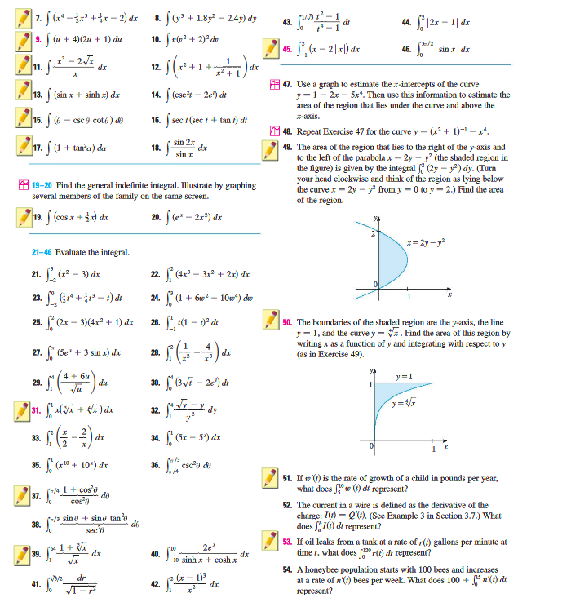
Notes:
20)
52) Change in charge from time a to time b
53)
54) 100 = initial condition, integral = change in bee population from week 0 to 15.
combined, they equal the total bee population at week 15

Slide 15
Particle Motion
A particle moves along a line so that its velocity at time t is v (t) = t² – t – 6 (measured in m/sec).
Find the displacement of the particle during the time period 1 ≤ t ≤ 4.
(b) Find the distance traveled during this time period.

Slide 16


Particle Motion: Solution
(a) By Equation 2, the displacement is

Slide 17


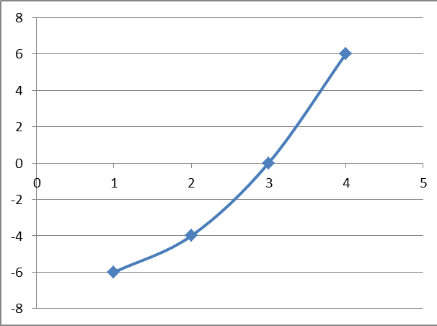
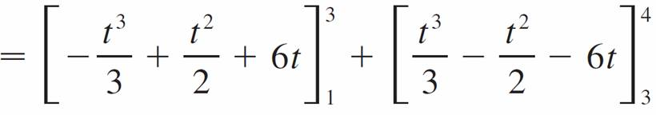
Particle Motion: Solution Cont’d
(b) v (t) ≤ 0 on the interval [1, 3] and v (t) ≥ 0 on [3, 4].
Vel(m/sec) = t^2-t-6
Starts out heading left (-), then slows down and turns right (+)

